Slide 1
Strategic Transformation
& FCFO Leadership
MAATHAVAM CONSULTING PRIVATE LIMITED
Rajkumar M
Founder & Managing Partner
FCA · ICWA · CMA · CFM (US)
Six Sigma · Digital Transformation
Founder-led advisory that converts finance from a transactional function into the strategic value engine of the enterprise, supporting business leaders on outcomes
30+
YEARS OF LEADERSHIP
Cognizant · Shell · Maersk
Standard Chartered · Agility
LEADERSHIP
TRANSFORMATION
MULTI-INDUSTRY
CXO-grade strength — 1000+ FTEs enabled globally
End-to-end delivery — tangible efficiency gains
5+ industries — tech, energy, banking, logistics
Company Profile · 2026

Slide 2
What We Do for You & Your Teams’ Success
SERVICE ARCHITECTURE
Six services, one accountable partner supported by a senior team — scoped to the stage and ambition of your business.
1
CFO & Business Partnering
2
Organisational Transformation
Strategic financial leadership without the full-time cost; trusted advisor to CXOs on high-stakes decisions.
Change leadership to modernise operations, deploy digital tools and build resilient, scalable structures.
3
Program tailored support
4
Cash Flow & Cost Engineering
End-to-end support for mergers, acquisitions, restructuring and post-deal integration.
Advanced cost engineering and working-capital management to free liquidity and fund growth.
5
High-Performance Finance Teams
6
C-Suite & Board Advisory
Building and mentoring teams, establishing competency frameworks and ensuring operational continuity.
Independent director services and executive sounding board to elevate governance and board oversight.
“Transforming finance from a transactional function into a strategic value engine.”

Slide 3
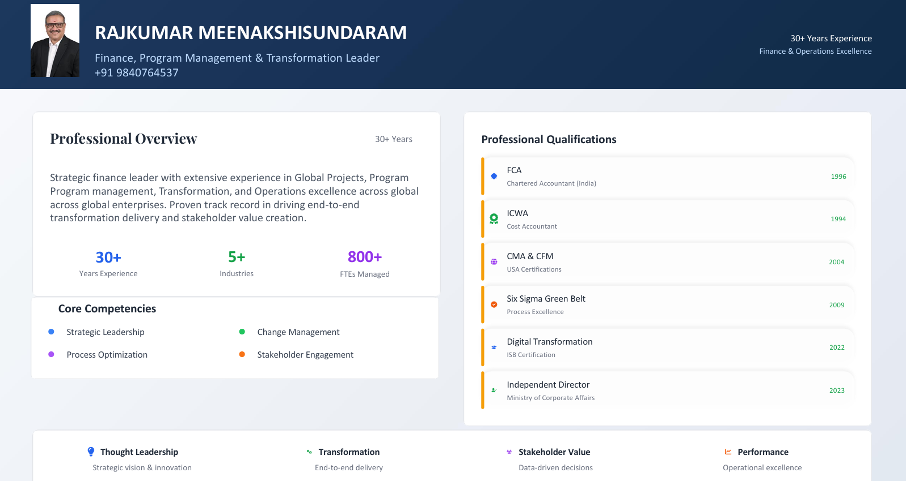
Rajkumar Meenakshisundaram
30+ YEARS EXPERIENCE
Finance, Program Management & Transformation Leader
FINANCE & OPERATIONS EXCELLENCE
+91 98407 64537 · +91 93636 34537
Strategic finance leader who converts finance functions into strategic value engines — leading global programs, transformation and operations excellence with end-to-end delivery and stakeholder value creation. Focused on business success. Rajkumar Meenakshisundaram - Portfolio
CREDENTIALS & GOVERNANCE
2023
Independent Director
Ministry of Corporate Affairs
2022
Digital Transformation
Strategic Leadership · Change Management & Transformation
Process Optimisation · Stakeholder Engagement
Indian School of Business
2009
Six Sigma Green Belt
30+
5+
100+
Process excellence
2004
CMA & CFM (US)
YEARS EXPERIENCE
INDUSTRIES
FTEs ENABLED
Management accounting
1996
FCA
“Raj was resilient during 2020. He demonstrated true leadership while navigating a demanding agenda.”
Chartered Accountant, India
1994
ICWA
Cost Accountant
— SVP Finance, Agility
MAATHAVAM CONSULTING PRIVATE LIMITED · COMPANY PROFILE

Slide 4
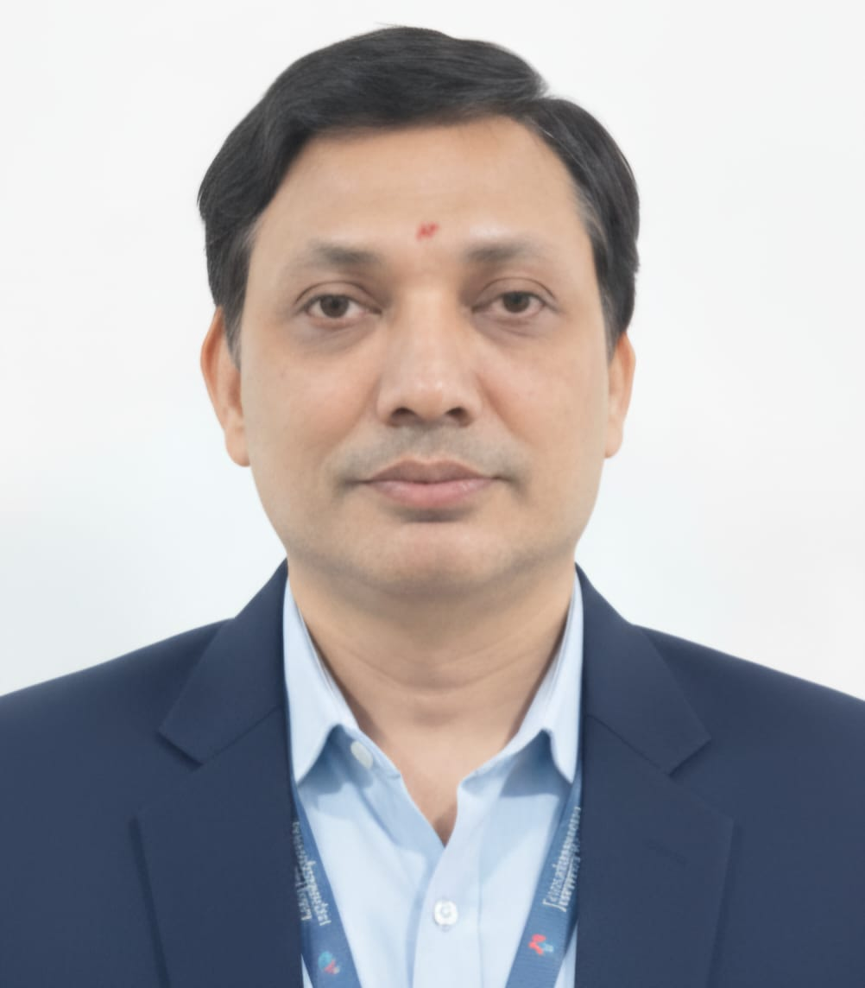
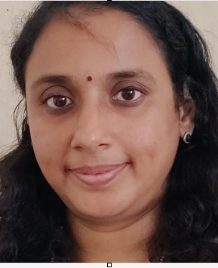
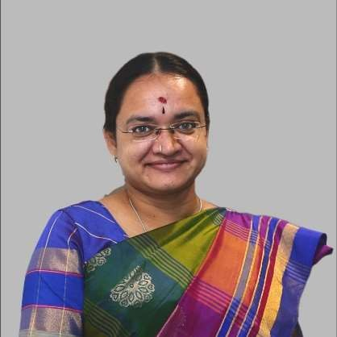
Led from the Front
LEADERSHIP TEAM
Every mandate is supported by a great team — senior finance and transformation specialists with global pedigree.
Srinivas Sharma M
Deepa Kumar
Sinduja Kamalvishnu
23+ Yrs · ACA · Six Sigma
22+ Yrs · ACA
22+ Yrs · ACA . Lean Sigma
Genpact · IBM · Agility
Cognizant · Standard Chartered · Maersk · Accenture
Trane Technologies · Philips · Cognizant · Shell
Finance & accounting operations
Service delivery leadership
Process optimisation
High-performance teams
Metrics & scorecards
Business finance partnering
Systems integration
Shared services delivery
Finance shared services & RTR
FP&A, budgeting & analysis
Lean & process excellence
Global teams of 60+ members
MAATHAVAM CONSULTING PRIVATE LIMITED · COMPANY PROFILE

Slide 5
Proven at Global Scale, Deployed on Live Mandates
TRACK RECORD
The leadership team’s operating pedigree, proven outcomes — and where it is engaged today.
WHERE WE’VE LED
Cognizant
Shell
Standard Chartered
Maersk
Agility
Genpact
Philips
Accenture
PROVEN OUTCOMES
Transformation Delivery
Cost Optimisation
Talent Development
Stakeholder Value
Turned around shared-services performance and engagement scores.
Delivered strong cost goals via re-engineering and continuous improvement.
Built knowledge base and career paths across global operations.
Moved shared services from transactional to value-add partner.
CURRENT MANDATES
CFO MANDATE
CFO MANDATE
CFO MANDATE
TRANSFORMATION
Technology — Data Masking
Technology — Data & Analytics
SaaS Product — Logistics
Digital Marketing
“The professionalism and dedication you have shown helped us to finalize the integration with success.” — EVP Finance, DSV Panalpina

Slide 6
How We Work Together
ENGAGEMENT & NEXT STEPS
Choose the engagement model that fits your stage — every model is partner-led.
FCFO Retainer
Programme Delivery
Advisory Sprint
Ongoing strategic finance leadership on a fractional cadence, with board-ready reporting and full financial oversight.
Defined-scope change programme with milestones, governance and measurable outcomes owned end to end.
Targeted intervention — Program based support, cost and cash review, ERP readiness or a finance function diagnostic.
Best for scaling enterprises
Best for step-change
Best for focused starts
YOUR PATH FORWARD
01
Discovery Session
02
Customised Roadmap
03
Phased Rollout
“Key internal stakeholders provided positive feedback on the improvement and expressed their confidence.”
Rajkumar M · Founder & Managing Partner
+91 98407 64537 · +91 93636 34537
— Global CFO, Agility
rajkumar@maathavam.com

